Slide 1
Old data
New data

Slide 2
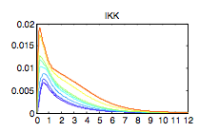
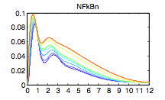
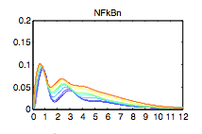
Didn’t change IKK simulation results.
New data
n(10:12)= [5; 37; 37 ]; % inducible txn delay
n(30:32)= [0.828; 0.414; 0.414]*0.1; % IkB:NFkB Export
Didn’t change IKK simulation results.
n(10:12)= [10; 37; 37 ]; % inducible txn delay
n(30:32)= [0.828; 0.414; 0.414]*0.1; % IkB:NFkB Export
Didn’t change IKK simulation results.

Slide 3
Single cell model
Randomize the MyD88 and TRIF activation together (0~1 fold range)
Technical Problems:
1. Second peak is not strong enough.
2. The trough of first peak is a little bit high
3. Possible of 3rd peak not shown in simulation.
Old experimental data

Slide 4
Single cell model
Randomize the MyD88 and TRIF activation together (0~1 fold range)
Technical Problems:
1. Second peak is not strong enough.
2. The trough of first peak is a little bit high
3. Possible of 3rd peak not shown in simulation.
New experimental data

Slide 5
Single cell model
Randomize the MyD88 and TRIF activation together (0.1~10 fold range)
Technical Problems:
1. Second peak is not strong enough.
2. The trough of first peak is a little bit high
3. Possible of 3rd peak not shown in simulation.
New experimental data

Slide 6
Single cell model
Randomize the MyD88 and TRIF activation together (0.1~10 fold range)
Technical Problems:
1. Second peak is not strong enough.
2. The trough of first peak is a little bit high
3. Possible of 3rd peak not shown in simulation.
New experimental data

